Slide 1
In Situ Affect Detection in Mobile Devices: A Multimodal Approach
Presented by
Mohammad Adibuzzaman
Department of Math, Statistics and Computer Science
Marquette University

Slide 2
Affective Computing

Slide 3
Affective Computing
Affect means Emotion
A popular term used for Emotion in Psychology
Affective computing is the study of automatic detection, synthesis and analysis of emotion

Slide 4
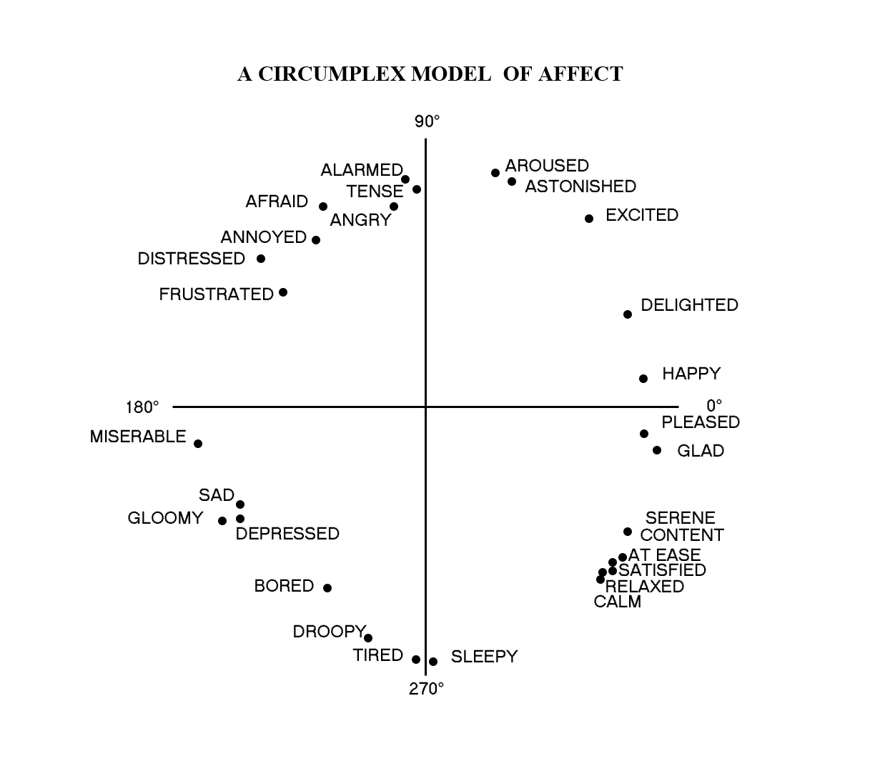
Theory Of Emotion(Russell’s Dimensional Model from Psychology)
Arousal
Valence
[Russell 89]

Slide 5
Computing Aspects
Facial Expression
Speech
Gesture
Body movement
Heart rate, Temperature, Brain Signal
Highly interdisciplinary in nature
Computer Vision, Machine Learning, Psychology, Social sciences, Cognitive Science

Slide 6
Motivation

Slide 7
Motivation
Wide range of applications
New dimension to human-computer/human-robot interaction
Robotics
Application in user interface design
Learning environment
Boredom, Frustration
Autism spectrum
Early intervention for stress reduction
Mental Health Monitoring

Slide 8
Motivation (Contd.)
Why Mobile device?
Remarkable progress in the last few years
In memory, storage and computational capabilities of the smart and handheld devices
Mobile phone subscriptions grew from 12.4 million to over 4.6 billion(1990-2010)
Can be used for
Mental Health Monitoring
Advertisement
Affect Sensitive User Interface

Slide 9
Motivation (Contd.)
Why Multimodal?
In real life people understand affect of other people not only from face, but have overall idea about emotion from all aspects
This would likely to improve the accuracy of the system

Slide 10
Related Work

Slide 11
Related Work: Facial Expression
Most facial expression research has been inspired by the work of Paul Ekman . These works were based on the Facial Action Coding System (FACS) proposed by Ekman
Image processing algorithms are also used to extract the important features using machine learning algorithms to classify into different emotional categories

Slide 12
Related Work: Speech
Difficulty with an appropriate identification of a feature space to be used in classification
Emotion recognition is typically performed using neural network, SVM and Hidden Markov Model on certain acoustic features
[Ververidis 2006]

Slide 13
Related Work: Physiology
Measures used to identify physiological activity include
Electromyogram (EMG) that measures muscle activity
Electrodermal activity (EDA) that measures electrical conductivity and
Electrocardiogram (EKG) that measures heart activity
[Andreassi 2007]

Slide 14
Previous Work

Slide 15
Research Questions (Previous Presentation)
Inherent theory of emotion is not established
The theory of emotion is not established yet.
Finding the features
Understanding those ideas and adapting those to any computational methods
Expression of emotion greatly varies from person to person, man and women, and also among different age and race
Real environment versus simulated environment
Privacy

Slide 16
Our Approach

Slide 17
Our Approach
Selecting modalities
Used Russell’s 2D model
Valence
Facial Image
Arousal
Heart Rate
Pupil Size
Energy Spent
Building classifier for each of the modalities
Evaluate the performance of the single modalities
Fusing the result of different modalities
Validate the performance of the multimodal system

Slide 18
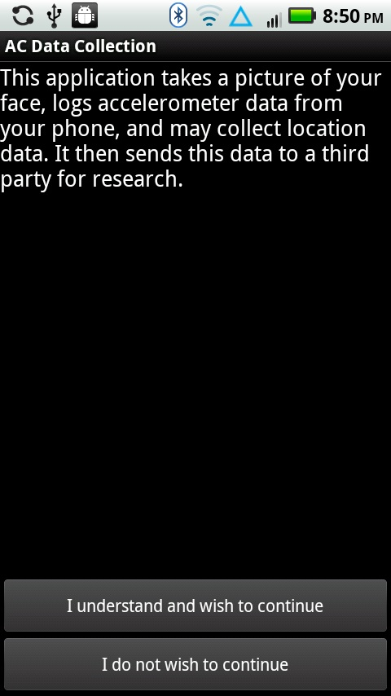

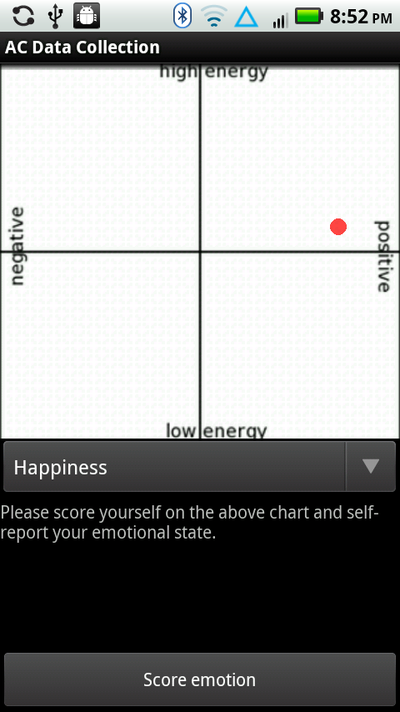
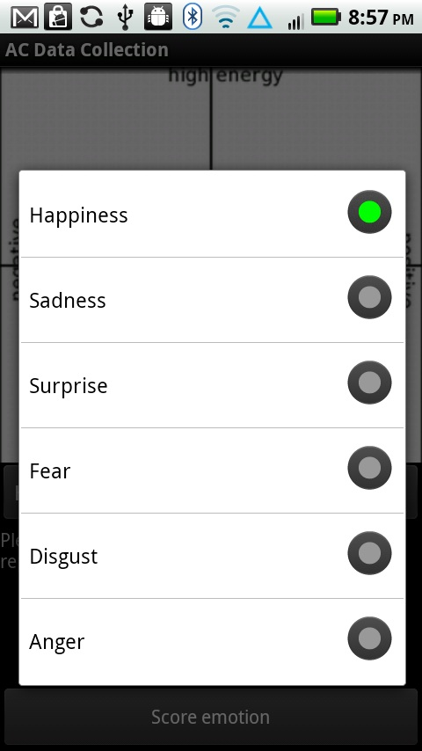
Software Design

Slide 19
System Design

Slide 20
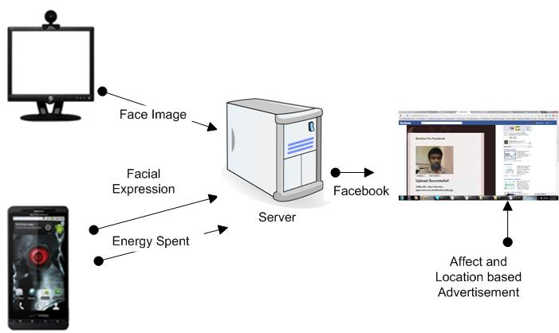
System Architecture

Slide 21
Affect from Facial expression
Used eigenface algorithm
Principal Component analysis to extract the important features for different emotional categories
Six basic expressions
Anger
Fear
Happiness
Neutral
Sadness
Surprise

Slide 22
Energy Data from Accelerometer
We need to correlate accelerometer data with energy expenditure.
This scalar value is considered accelerometer energy spent by the user.
The accelerometer energy is calculated according to the following formula:

Slide 23
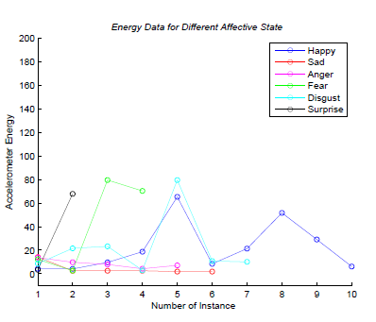
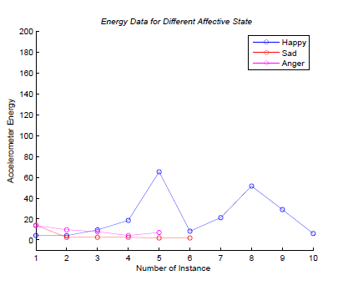
Energy Data from Accelerometer

Slide 24
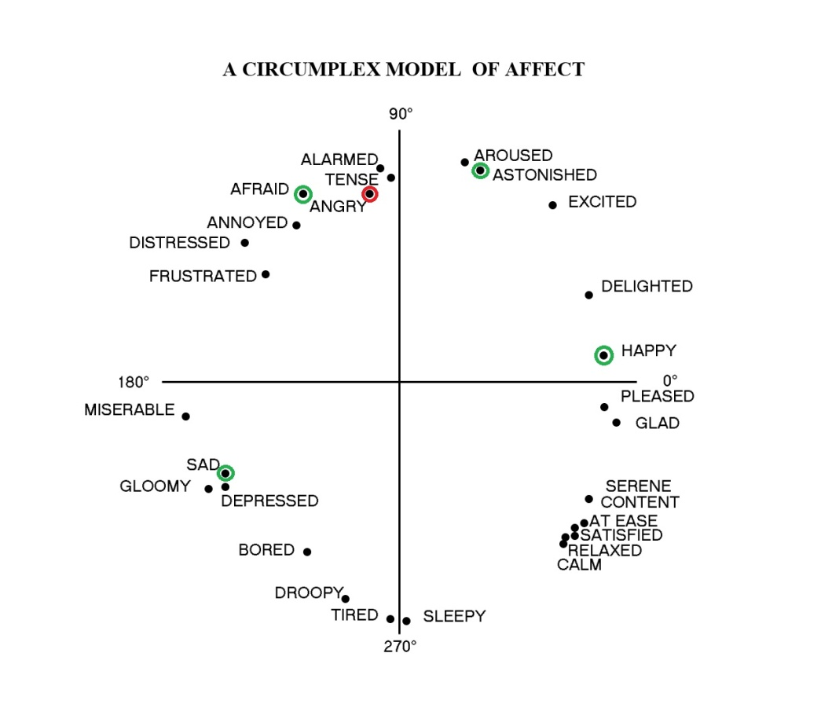
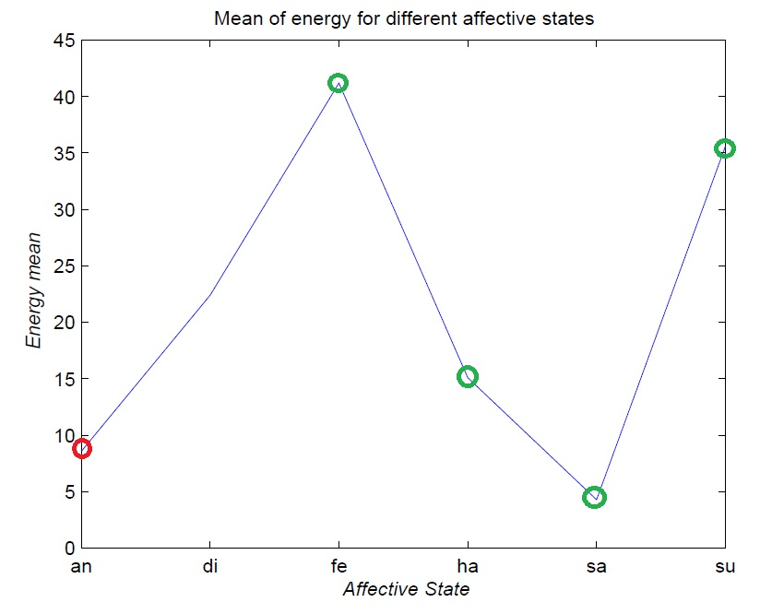
Accelerometer Mean and Russell’s 2D Model

Slide 25
Fusion

Slide 26
Fusion Using Naïve Bayes
Heart Rate
Pupil Size
Facial Expression
Energy
┴
Features
Happiness
Anger
Sad
Fear
Surprise
Classes

Slide 27
Fusion Using Naïve Bayes
It is argued that human behavior is close to that predicted by Bayesian decision theory
Since we are working only on two features with potentially large data for training, Naïve Bayes Algorithm would be a better fit
[Kording 2006]

Slide 28
Naïve Bayes
In simple terms, a Naïve Bayes classifier assumes that the presence (or absence) of a particular feature of a class is unrelated to the presence (or absence) of any other feature, given the class variable

Slide 29



Naïve Bayes (Contd.)
In other words, within each class of instances, the different properties can be determined independently
for all i
Where
Based on this independence assumption, the model factorizes to

Slide 30
Results

Slide 31
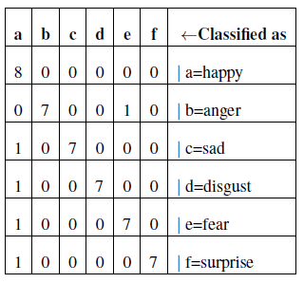
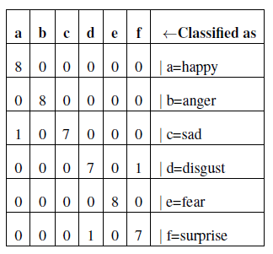
Confusion Matrix For Facial Expression
Confusion Matrix After Fusion

Slide 32
Future Work
Independence Assumption
May not be correct
Strong independence assumption reduces performance when features are strongly correlated
Constructing Bayes Net
Needs different probabilities for causal flow
Finding the active trails to identify probabilistic flow

Slide 33
Future Work
Developing a robust computational model that will be a good fit for affect detection
Explore other modalities like heart rate, temperature, speech, pupil size
Analysis of the perception of human-computer interaction using affect

Slide 34
Questions?

